Slide 1
Hilliard Sports Commission
Findings and Recommendations April 2019

Slide 2
Agenda
Introduction
Objectives
Fees and Scheduling
Ensuring Opportunities for All
Field Maintenance
Outdoor Field Demand
Outdoor Field Space
Indoor space
Economic Development
Next Steps

Slide 3
Objectives
Develop a strategy for “fair” administrative practices (including fees, scheduling and maintenance.
Include opportunities and experiences for all ages and abilities.
Develop a strategy for the “best” use of Recreation and Parks outdoor facilities.
Develop a strategy for indoor space.
Develop a strategy for economic development.

Slide 4
Recommendations – Fees and Scheduling
Form a single point youth sports coordination organization within the Recreation and Parks Department to serve as central coordinator for use of fields and facilities for youth groups.
Youth sports organization would be the single point of contact for organizing tournaments using city and school fields.
Establish organization board which would establish policy criteria in which the youth sports organization would govern.
Adopt classification system for youth sports groups, to prioritize those serving the broader community – 3 tiers
Establish scheduling policies which prioritize field usage based on tier
Develop fee structure which equitably shares cost of field usage with youth groups.
Implement standardized software platform for scheduling which integrates city and school processes
Standardize contracts for sports groups using fields.

Slide 5
Recommendations – Ensure Opportunities for All Ages and Abilities
Ensure availability of athletic opportunities for everyone, including groups particularly at-risk of not having adequate athletic opportunities (e.g., low socio-economic status. senior citizens, persons with physical or mental disabilities, etc.).
Form foundation to provide athletic opportunities for at-risk groups. This foundation would interact directly with the central youth sports coordinator .
Incentivize existing organizations that do not turn athletes away, regardless of ability to pay, etc.
Encourage organizations to provide a certain number of scholarships to reduce or eliminate fees.
Reach out to partner with existing foundations to help reduce fees that prevent low income individuals from participating..

Slide 6
Recommendations – Field Maintenance
Establish written standards for field maintenance, improvement, and pre-competition field preparation.
1
Expand Recreation and Parks in-house capacity to provide maintenance and pre-competition field preparation.
2
Form partnerships with local businesses for maintenance services needed to augment those provided by the city.
3
Contract with local youth sports clubs to care for the smaller “satellite” fields.
4

Slide 7
Findings – Current Demand and Needed Fields
41
38
35
35
29
27
Multi-Use Fields – Soccer, FB, Lacrosse
Ball Diamonds

Slide 8
Recommendations – Outdoor Field Space
Build additional sports field capacity for use by Hilliard area residents including soccer, baseball, softball, and alternative sports, using a phased approach
Option 1 – Utilize Grener Site for development of sports park
Sports Park would include – Miracle Field (in progress)
Other fields and facilities could include - multi-sport turf and synthetic turf fields, ball diamonds, pickle ball courts, outdoor hockey, playground, concession area, vender space, restrooms, etc.
Option 2 – Pursue other large tracts of land for sports field development
50+ acre parcel inside City limits
Expand Roger Reynolds Municipal Park
Approach Franklin County Agricultural Society to explore co-use and expansion of outdoor sports fields on Franklin County Fairgrounds

Slide 9
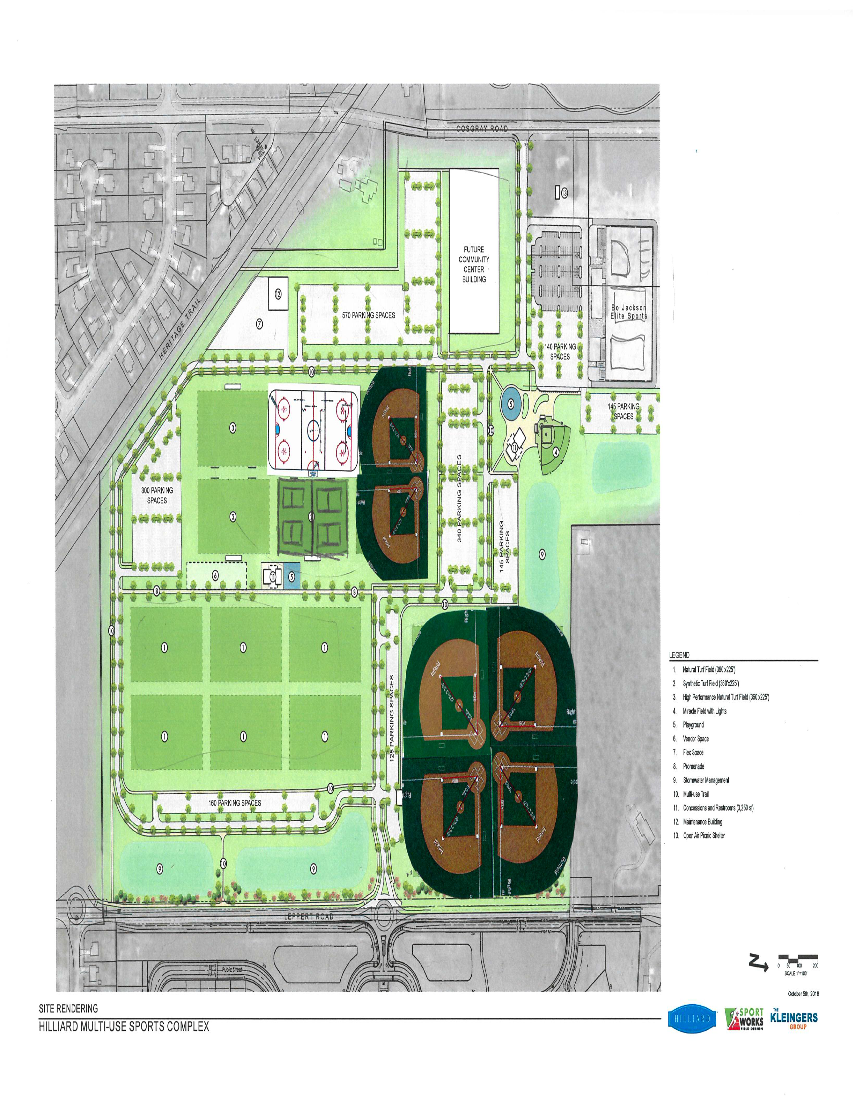
Conceptual Image
DRAFT

Slide 10
Recommendations – Indoor Space
Develop an indoor facility for court sports and recreation, using either city financing or third party
Option 1 – Build a facility at the Grener site
Option 2 – Modify and expand the Community Center at Municipal Park

Slide 11
Recommendations - Economic Development
Utilize the central coordination group to organize and recruit tournaments using city and school facilities
Develop revenue sharing policy to benefit city and schools as well as youth sports groups.
Approach Franklin County Agricultural Society to explore possibility of developing and co-using an indoor sports complex and event center on a Franklin County Fairgrounds site.

Slide 12
Next Steps
Short Term -
Communicate recommendations and gain feedback from - School, Local Sports Organizations , Townships, Franklin County Agricultural Society, Local Business
Form single point youth sports coordination organization (Hilliard Youth Sports Council) within the Recreation and Parks Department.
Include two members of the Sports Commission on organization's board to help facilitate the start-up of the organization.
Long Term –
Develop Grener
Review inventory of city and school fields and facilities.
Develop program of space needs for Grener and schedule for implementation.
Economic Impact
Study “regional” sports assets to discover what is missing or needed in region.
Identify strength in our sports community that we might build upon to fill a need currently lacking or missing in the region.
.

Slide 13
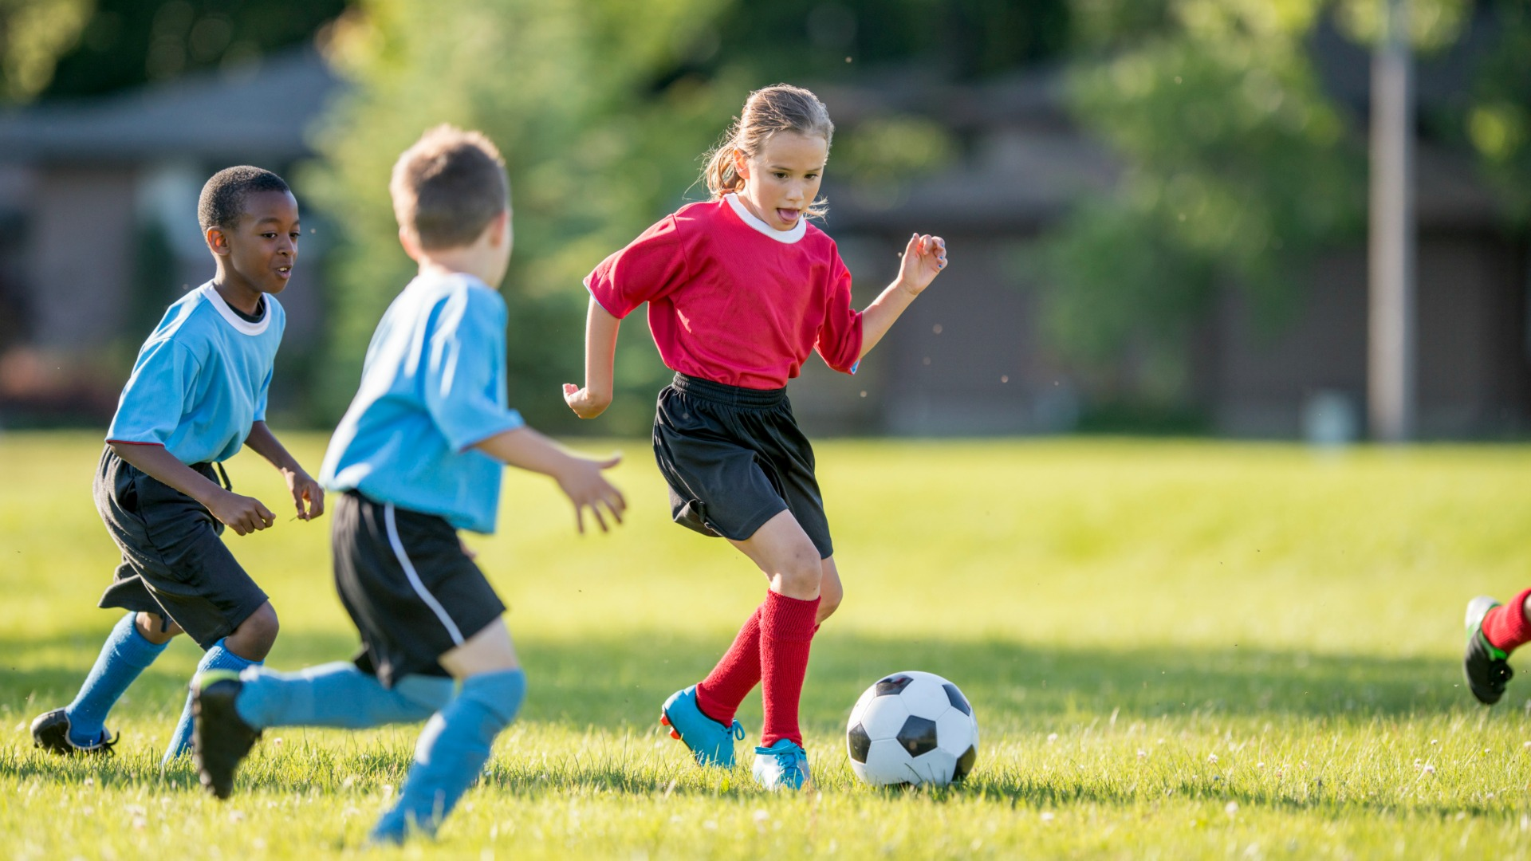
Hilliard Sports Commission
MAKING A REAL IMPACT. TOGETHER.

