Slide 1
SBA To Provide Economic Injury Disaster Loans
For Coronavirus Related Economic Disruptions

Slide 2
SBA’s Economic Injury Disaster Loan Basics
What businesses are eligible to apply?
Small businesses
small agricultural cooperatives
small aquaculture businesses
most private non-profit organizations
Must be:
directly affected by the disaster
located in the disaster area
2

Slide 3
SBA’s Economic Injury Disaster Loan Terms
How much can I borrow?
Up to $2 million.
3.75% for small business
2.75% for NFPs
How can I use the loan funds?
Fixed debt payments
payroll
accounts payable
other bills

Slide 4
Economic Injury Disaster Loan Terms
What are the collateral requirements?
Real estate preferred on loans over $25,000.
Lack of collateral is not a reason for decline.
4

Slide 5
Basic Filing Requirements
Application (Form 5 or 5C)
IRS 4506T for the applicant, principals and affiliates.
Business Federal Income Tax Return
Schedule of Liabilities (SBA Form 2202).
Personal Financial Statement (SBA Form 413).
5

Slide 6
Additional Filing Requirements
Other information that may be requested:
Personal Tax Returns for all principals.
Year-end financial statements
Interim (Current) P&L
SBA Form 1368 (Monthly Sales)
6

Slide 7
Ineligible Entities
What are some of the businesses that are ineligible for an Economic Injury Disaster Loan?
Farms
Religious Organizations
Gambling Concerns
Casinos & Racetracks
7

Slide 8
How to Apply
SBA’s Customer Service Representatives are ready to serve.
https://disasterloan.sba.gov/ela.
Paper loan applications can be downloaded from www.sba.gov/disaster. Completed applications should be mailed to: U.S. Small Business Administration, Processing and Disbursement Center, 14925 Kingsport Road, Fort Worth, TX 76155. (Not recommended.)
SBA’s Customer Service Center at 800-659-2955 can provide applications. disastercustomerservice@sba.gov.

Slide 9
Submit a COMPLETE Application As Soon As Possible
MISSING INFORMATION IS THE BIGGEST CAUSE OF DELAY

Slide 10
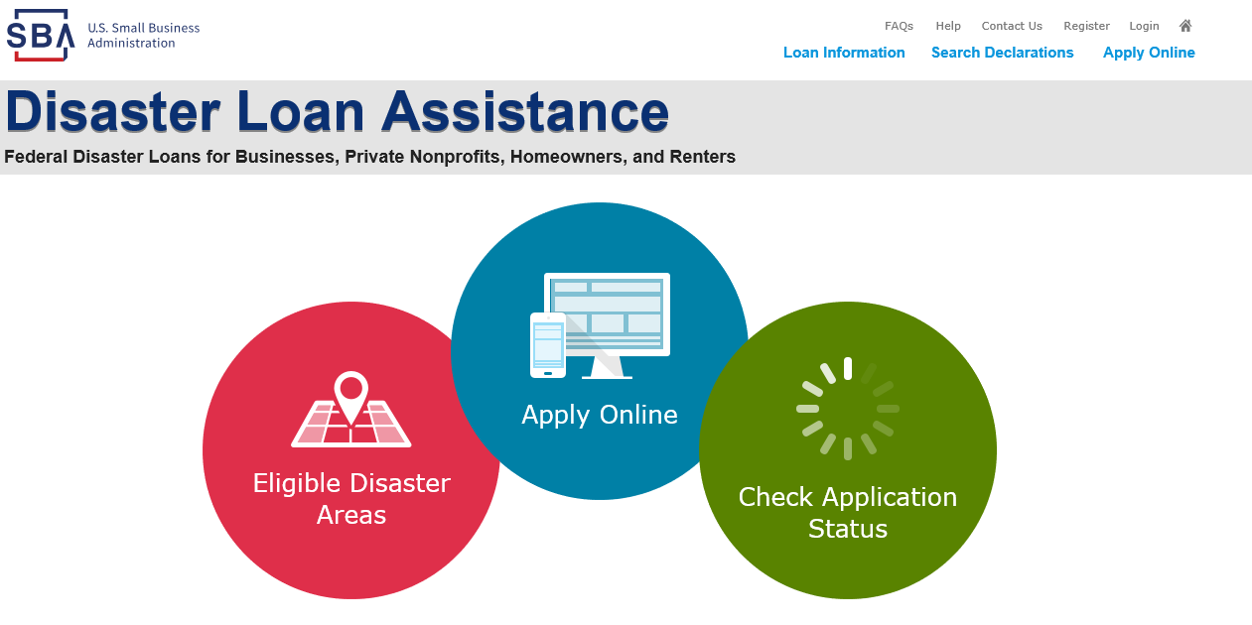
Disaster Loan Application Portal (DLAP)
DOUBLE-CLICK ON THE LINK TO ACCESS THE SITE
https://disasterloan.sba.gov/ela/
DOUBLE-CLICK APPLY ONLINE

Slide 11
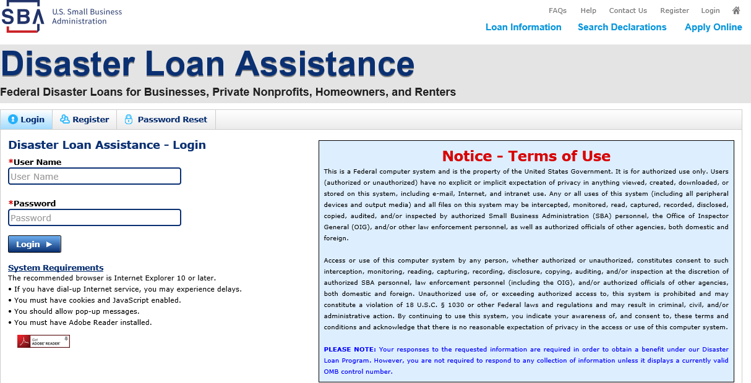
Register
From this page you can:
1) Begin a new application by clicking on Register
2) Return to complete a started application by inputting a user name and password

Slide 12
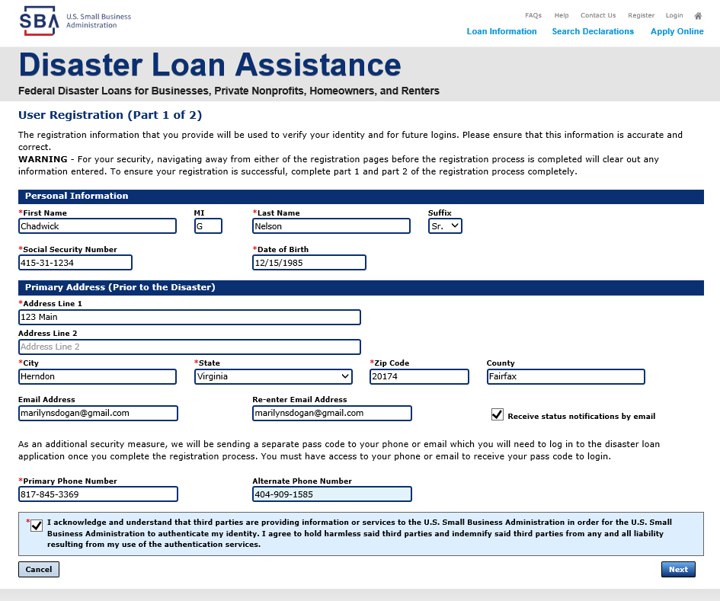
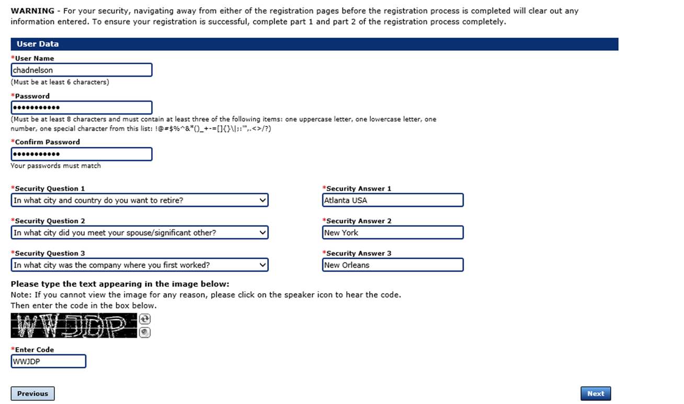
Complete Registration Information
On page 1 of the registration, pay close attention to the sections with an * these sections must be completed. It is important that a good email address and cell phone number are supplied.
On page 2 of the registration you will create your unique user-name and password. When creating your security questions, make sure to use information you won’t likely forget. If your password ever requires a reset, you would need this information
To advance to the next page, go next

Slide 13
SBA Columbus District Office
Dave Townsend: 614-427-0467 | david.townsend@sba.gov
Jerome Jones: 614-427-0476 | jerome.jones@sba.gov
Shannon Feucht: 614-626-7041 | shannon.feucht@sba.gov
Thalia Amador Lastra: 614-427-0407 | thalia.amadorlastra@sba.gov

Slide 14
SBA Cleveland District Office
Raymond Graves: 216.522.4192 | Raymond.graves@sba.gov
Mark Hansel: 216.522.4180 x230 | mark.Hansel@sba.gov
Tom Sangrik: 216.522.4180 x214 | Thomas.Sangrik@sba.gov
Tim Ensch: 216.522.4180 x213 | Timothy.Ensch@sba.gov

